Slide 1
Lambda Expressions

Slide 2
Lambda Expressions vs DEF
Lambda Expressions have the form:
lambda arg1, arg2, ...argN : expression using arguments
Ex : lambda x, y: x + y

Slide 3
Lambda Expression

Slide 4
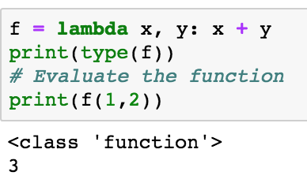
Lambda Expressions
They return a function or expression
That you can evaluate

Slide 5
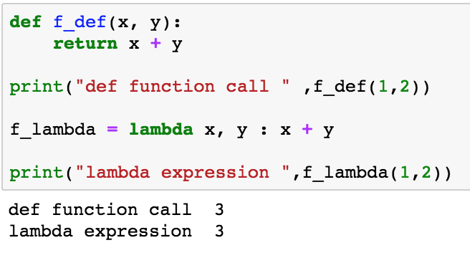
Compare Lambda to Def
Here def and lambda do the same thing

Slide 6
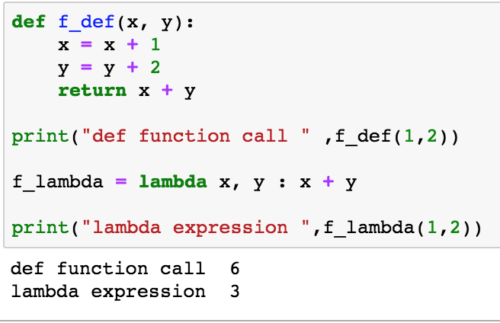
Compare Def and Lambda
Def can contain multiple statements in a block of code
Lambda is a one-liner

Slide 7
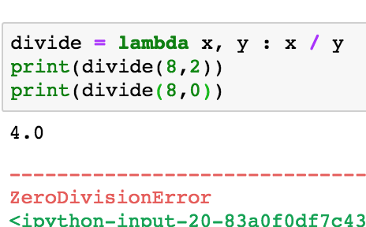
When you cannot use lambda
You cannot check exceptions with lambda expressions. Example divide by zero

Slide 8
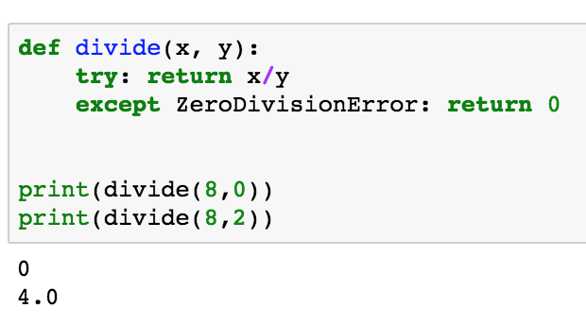
Use a Def if exceptions are possible

Slide 9
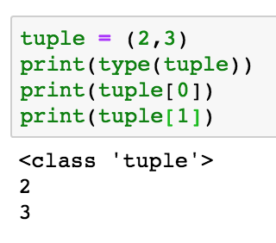
What are tuples?
How to declare them and how to access their values

Slide 10
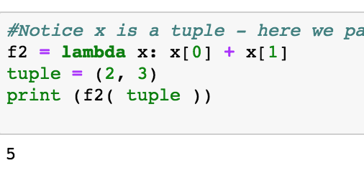
Tuples and Lambda Expressions

Slide 11
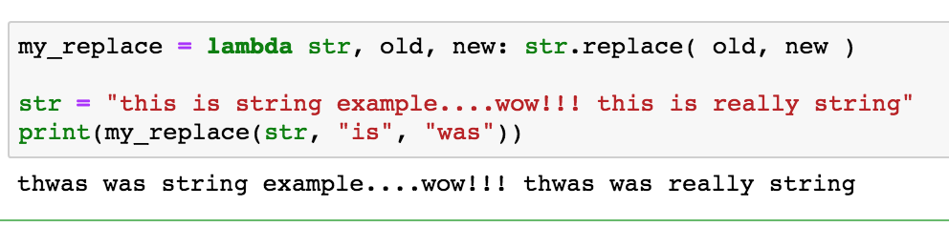
Lambda Expressions and String Type
String Replacement

Slide 12
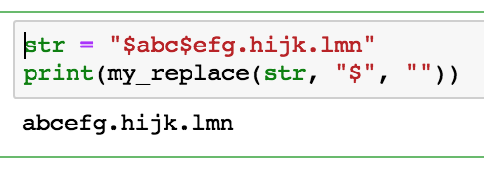
Another Example
Used to parse text files

